Slide 1
VA Web Brand Consolidation: VA.gov, Vets.gov, and Veterans.gov
United States Digital Service
15 May 2018

Slide 2
1. We are working now to fold Vets.gov into VA.gov and retire the Vets.gov website
By Veterans Day 2018, users will have access to the top Veteran-facing tools and content from VA.gov
New homepage
New global navigation
New benefit hubs
This is the first major step in consolidating VA’s diffuse web properties
Explore, MyHealtheVet, and eBenefits will still exist for now, but their functionality will continue to move to or get rebuilt on VA.gov

Slide 3
2. We are building a hub-and-spoke content model on VA.gov so there is one, canonical place for each Veteran benefit/topic with relevant cross-linking
Education and Training
Explore and Apply
Track and Manage
Other Resources
Careers and Employment
Explore and Apply
Other Resources
Track and Manage
GI Bill
Comparison
Tool

Slide 4
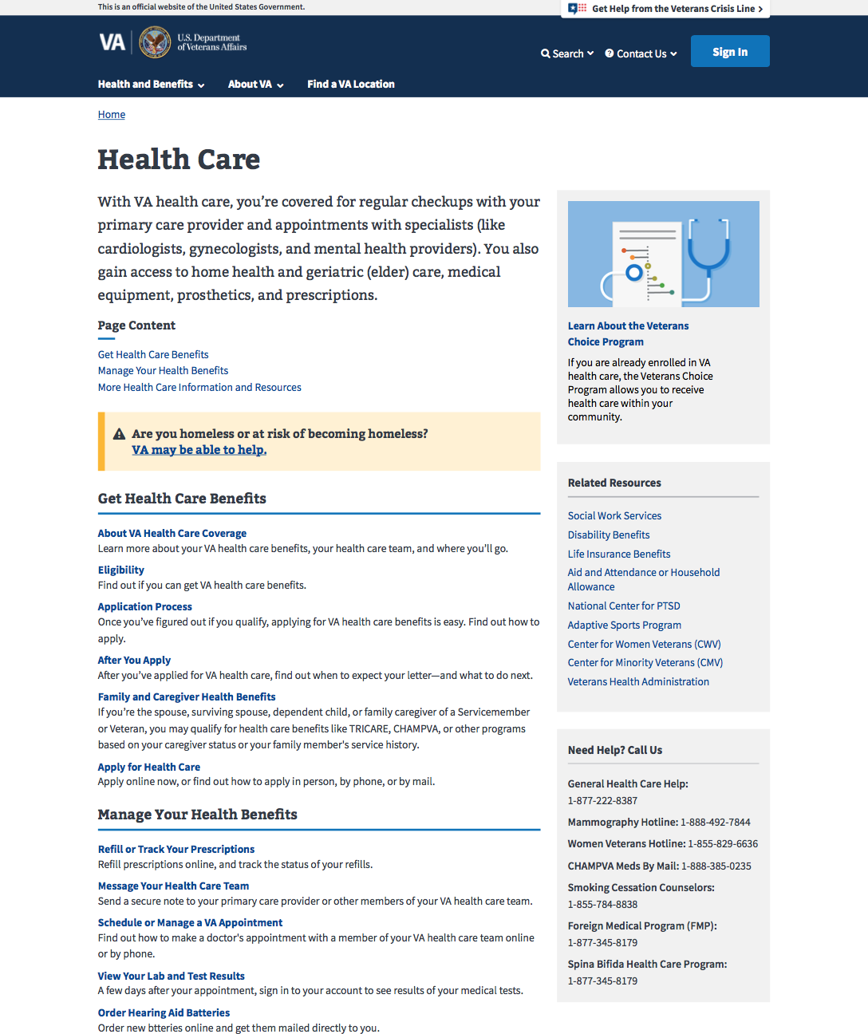
Benefit hub concept

Slide 5
3. We recommend DOL retire the Veterans.gov website and we fold relevant content into the new VA.gov Careers and Employment hub
This aligns with our global content hub-and-spoke model of providing one place for Veterans to find benefits information by topical hub
DOL’s Veterans.gov mostly links out to other resources, including Vets.gov (e.g., resume builder), VA.gov (e.g., VA jobs for Vets), and USAJOBS.gov (e.g., Feds Hire Vets), and many federal and state agency jobs websites
Users’ mental model for anything Veteran-related is to start at VA.gov

